Slide 1
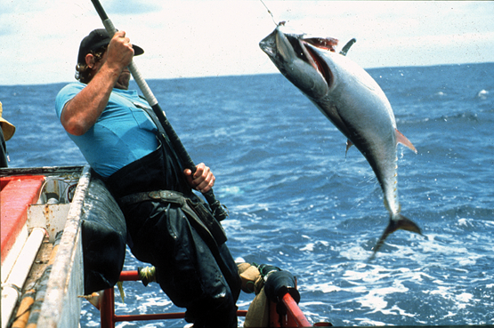
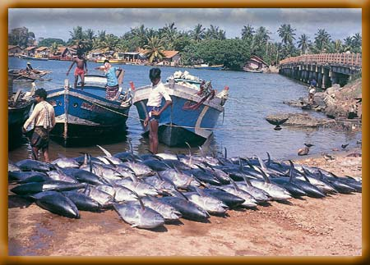
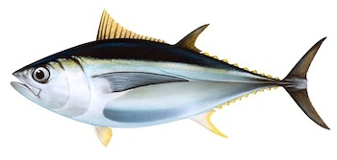

IOTC-2021-WPM12(MSE)-04 IOTC Bigeye Management Strategy Evaluation: March 2021 Update Dale Kolody Paavo Jumppanen CSIRO Oceans & Atmosphere, Australia

Slide 2
New CSIRO IOTC MSE Team starting ~ July 2021
Paavo Jumppanen
Ashley Williams
Rich Hillary
Ann Preece
Laura Tremblay-Boyer (?)
12 month funding opportunity from Australia identified - not confirmed

Slide 3
Outline
Software and documentation available from:
https://github.com/pjumppanen/niMSE-IO-BET-YFT/
Current status of reference set OM
No specific change requests at WPTT/WPM 2020
A new MP based on a Joint Process and Observation Error Random Effects Production Model
Candidate MP testing
Feedback requests & Proposed Workplan

Slide 4
BET 2020 Reference Set OM: Full reconditioning
Derived from Fu (2019) Stock Synthesis assessment (Methot and Wetzel 2013)
4 Areas
Quarterly dynamics 1950-2018
15 fisheries
Age-structured
Spatial BH Recruitment
Key differences between assessment and OM conditioning assumptions:
Temperate CPUE series simplification (renormalized by season and merged)
SS Recruitment deviation constrained for 12 quarters
OM initial N(age) = Assessment final N(age) + age-dependent error
7 Uncertainty dimensions in the OM grid

Slide 5
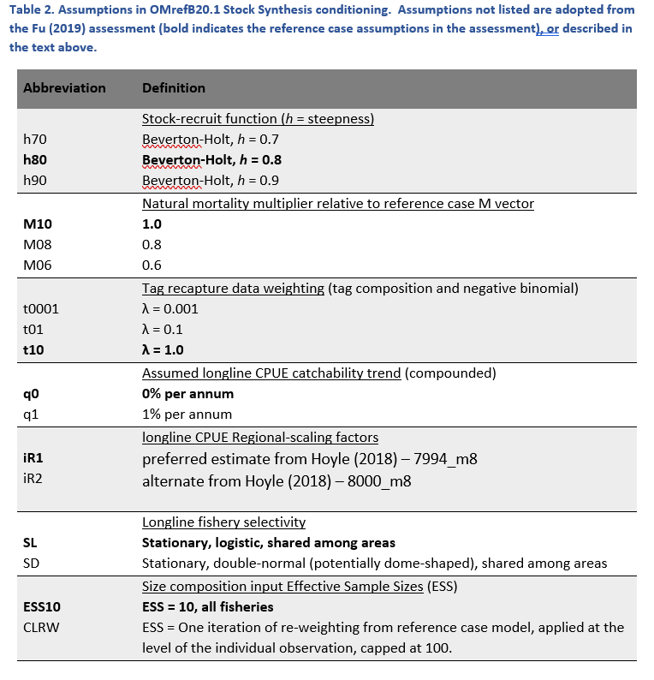
BET 2020 Reference Set Operating Model
7 Dimensions
Fractional factorial design of 72 models

Slide 6
Model plausibility evaluation
Inspection of various quality of fit indices for outlier behaviour
Detailed inspection of 4 most extreme models
Highest and lowest MSY
Highest and lowest depletion
Catch penalty in SS objective function
Not enough fish in the right age/region/quarter strata?

Slide 7
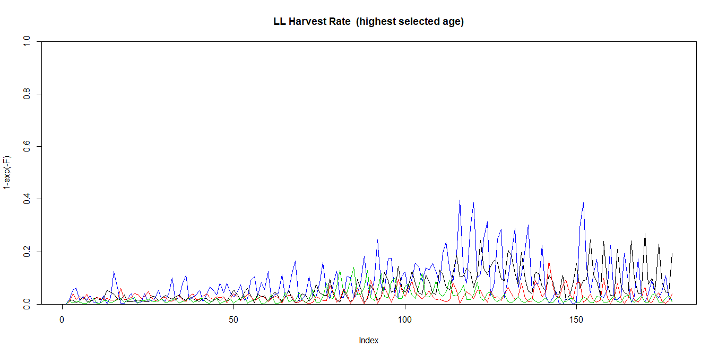
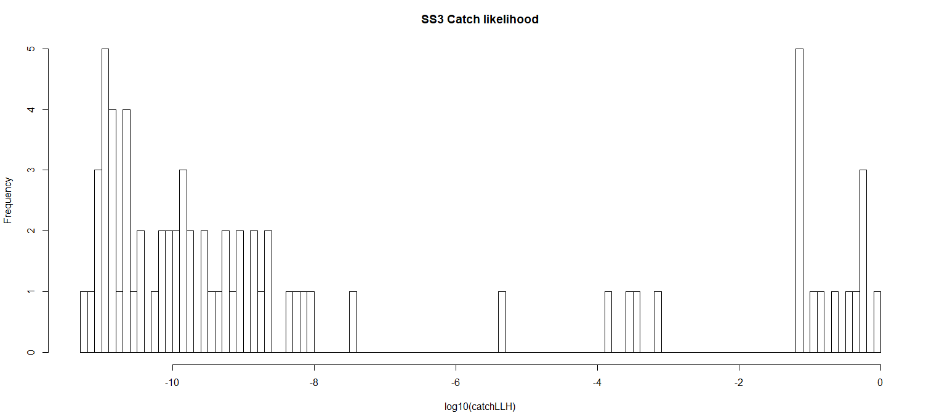
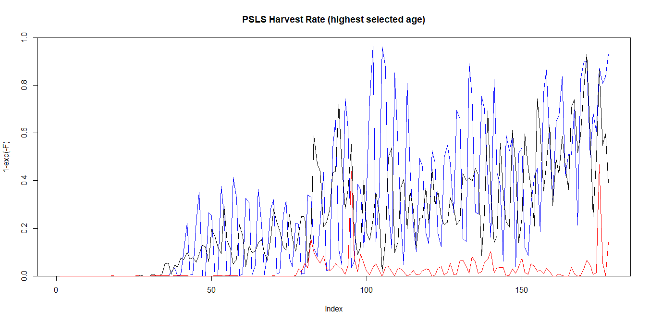
Harvest Rates (Highest selected age)
OM Catch Likelihood distribution
Longline max H ~ 0.4
Purse Seine LS max H = 0.99+
Seasonality artefact?

Slide 8
Bigeye Management Procedure Evaluation

Slide 9
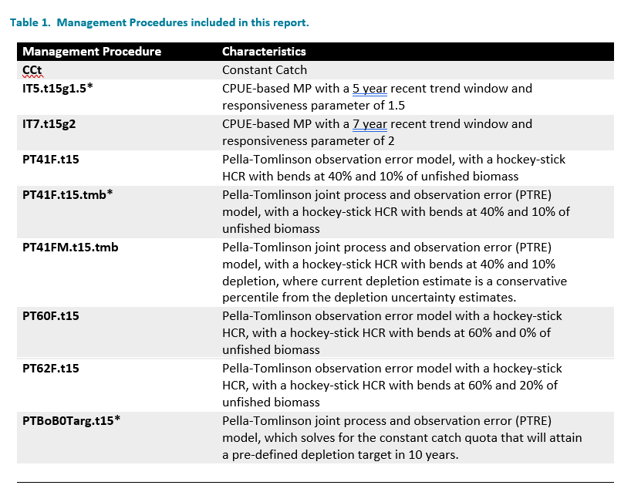
Mix of 9 MPs

Slide 10
CPUE-based MP – no developments

Slide 11
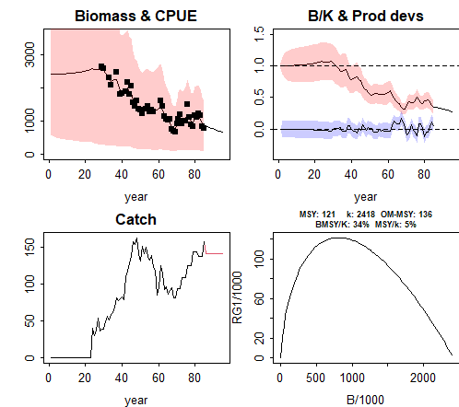
IOTC–2020–WPM11–13 Pella-Tomlinson Joint Process and Observation Error Random Effects Model (PTRE)
Implemented with TMB (Template Model Builder)
Fast (~1 second per application vs: JABBA 2-3 minutes)
Generally reliable, but priors and penalties required for stability
Error estimates may be useful

Slide 12
PTRE + Hockeystick
Recent development: Can incorporate uncertainty in Estimated Current Depletion
New PTRE Estimation Model
More uncertain X should be more precautionary

Slide 13
PTRE-based MP with internal projection
Fit PETR Model
Find constant TAC that hits target depletion at target date
B/B0 (Depletion)
Target depletion
Historical
Projection
Time
TAC setting
Target Date

Slide 14
Bigeye Candidate MP Evaluation Results
TCMP (2019) tuning objectives:
B18.2: Pr(Kobe green zone 2030:2034) = 0.6
B18.3: Pr(Kobe green zone 2030:2034) = 0.7
i.e. The stock status is in the Kobe green quadrant over the period 2030-2034 exactly 60% (or 70%) of the time (averaged over all simulations).
15% TAC change constraint

Slide 15
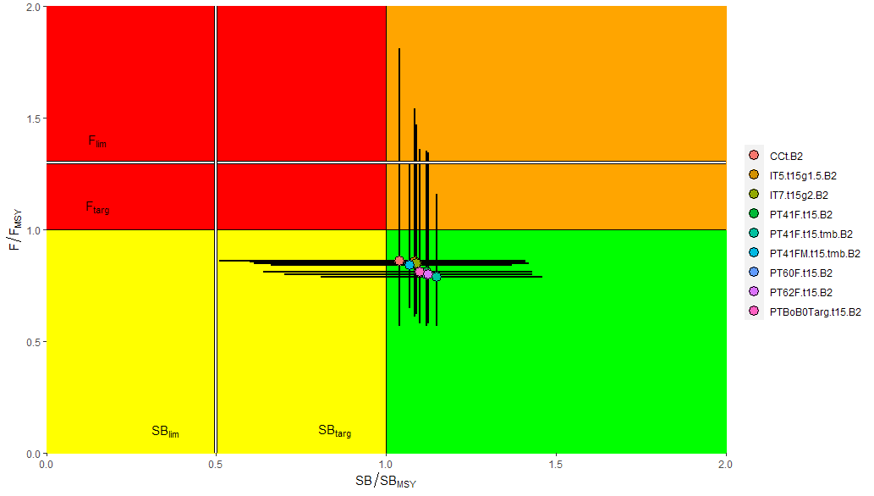
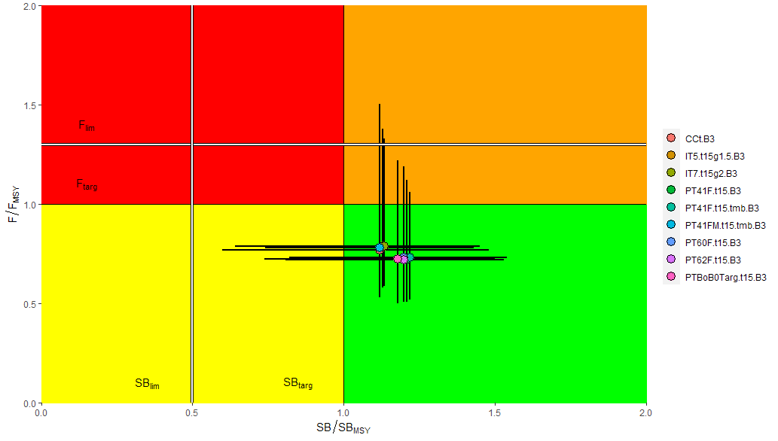
BET OM Reference Set MP Evaluation Results
15 year performance summary
Tuning B2
Tuning B3

Slide 16
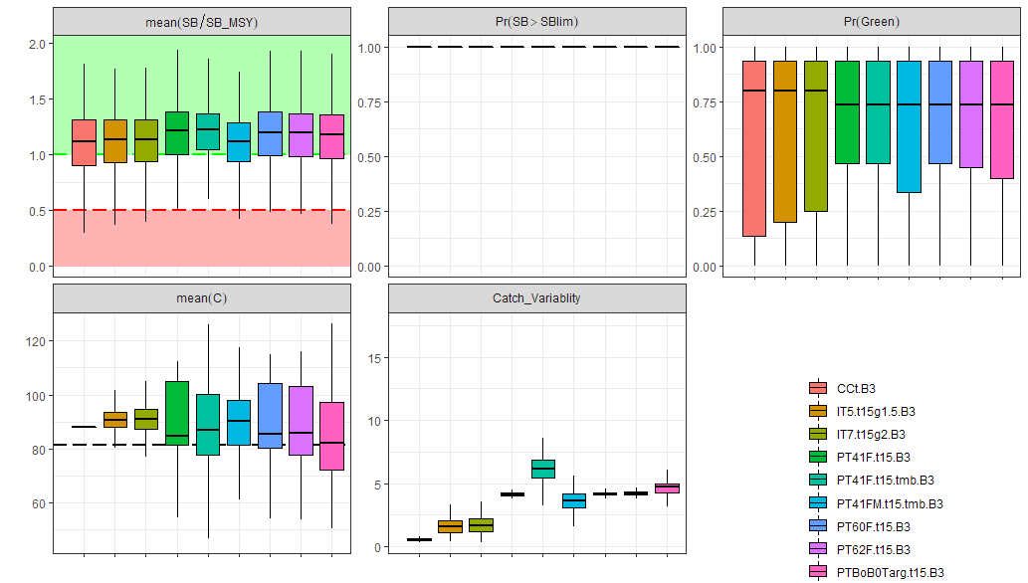
BET OM Reference Set MP Evaluation Results
15 year performance summary
Tuning B3

Slide 17
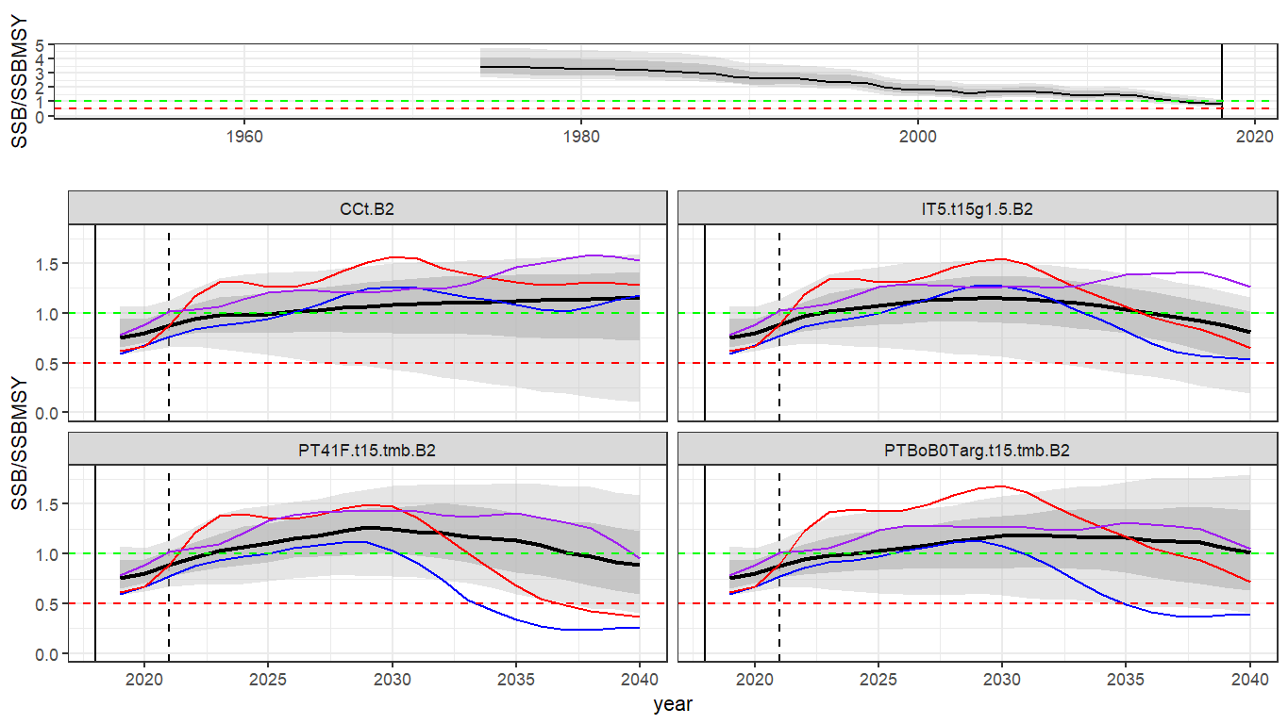
Key BET OM Reference Set MP Evaluation Results (Tuning level B2)
Median Biomass fairly consistent
Projection-based bit less risky that CPUE-based

Slide 18
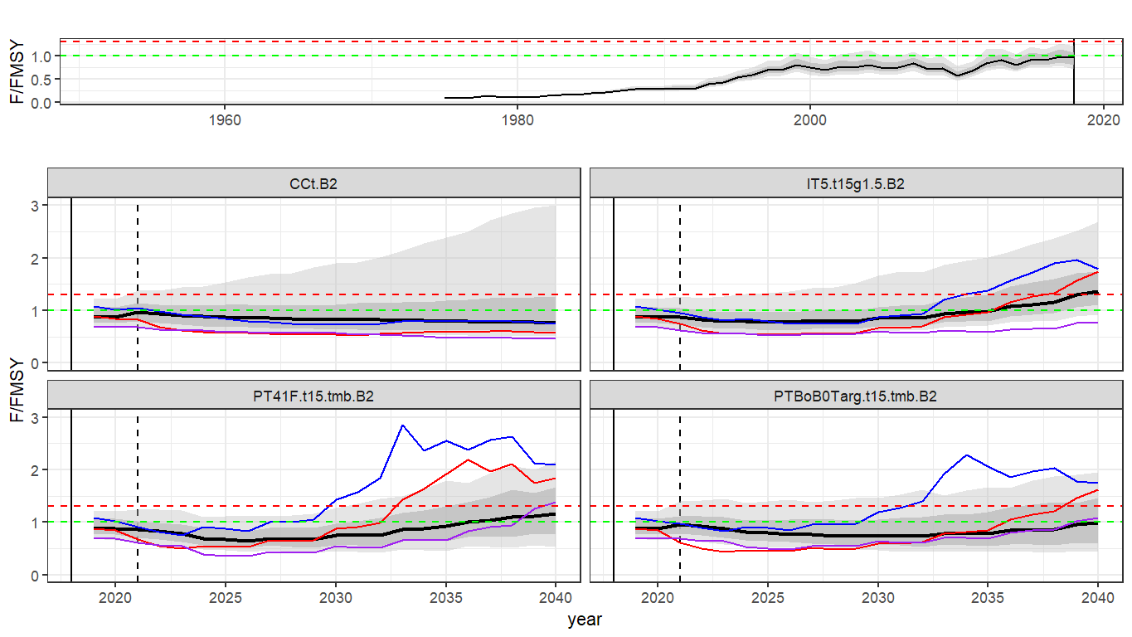
Key BET OM Reference Set MP Evaluation Results (Tuning level B2)
CPUE and hockeystick MP F trend exceeds target
Projection-based MP median F at or below target

Slide 19
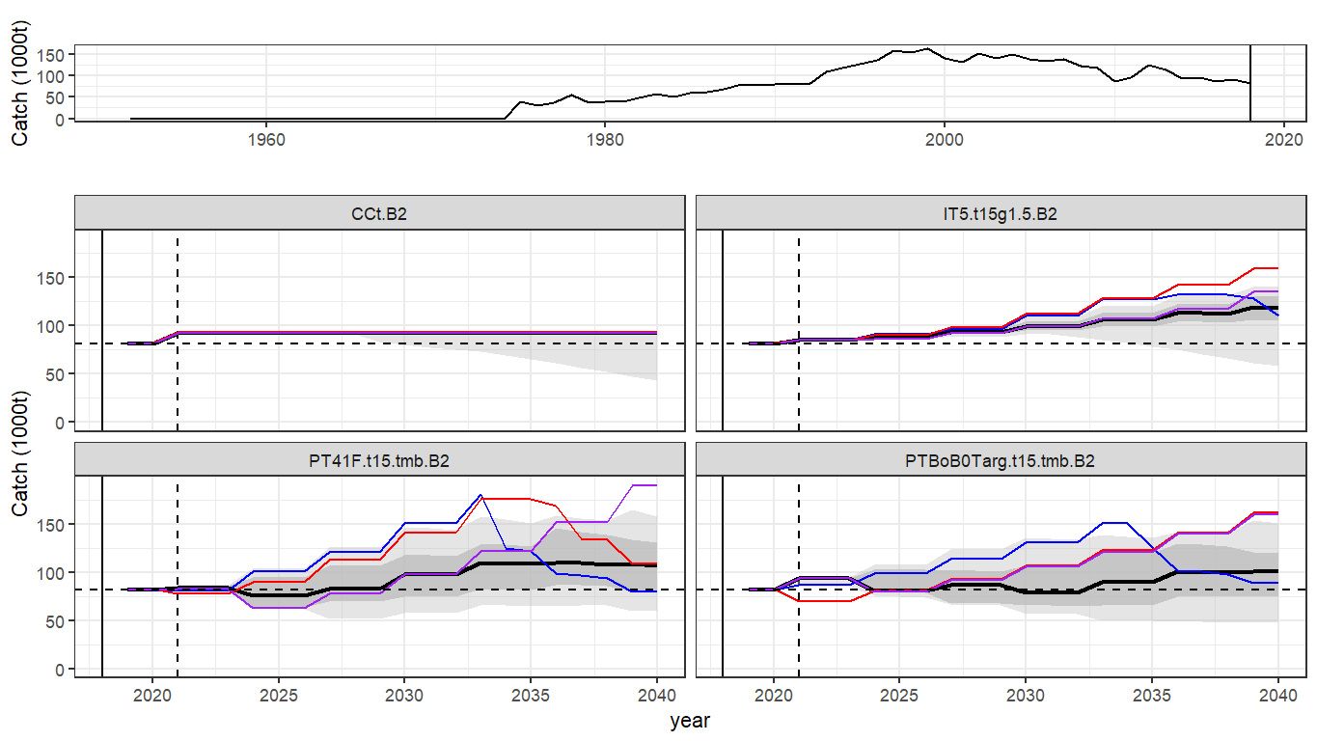
Key BET OM Reference Set MP Evaluation Results (Tuning level B2)
Median Catches slightly higher than current
Catch Trends with some MPs
TAC not always extracted …

Slide 20
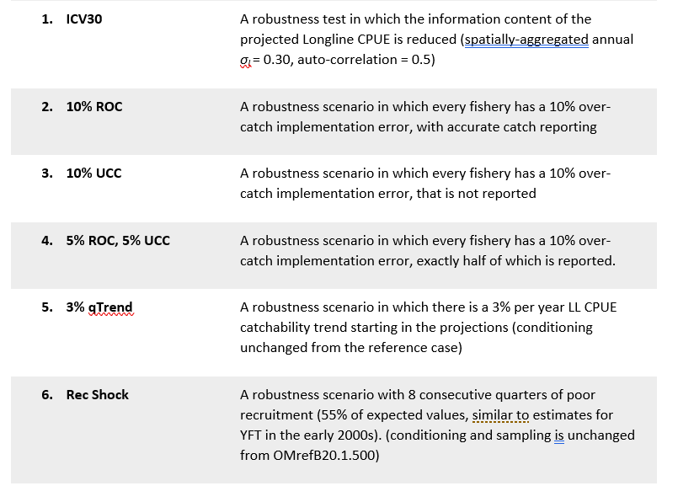
Robustness tests
New for 2021

Slide 21
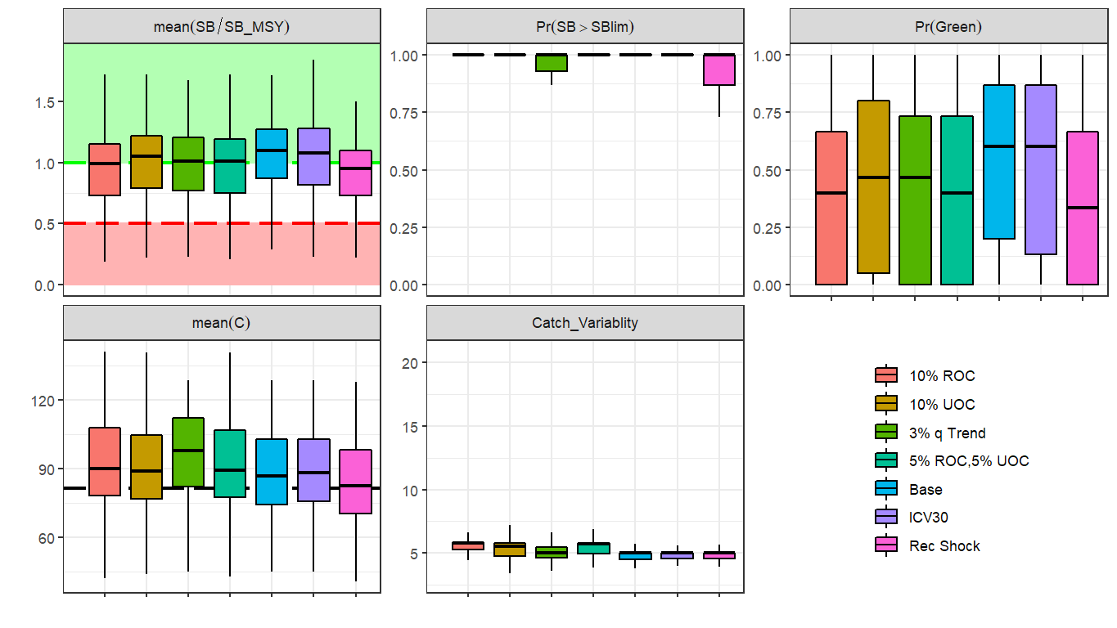
Robustness tests
Projection-based MP, B2 Tuning
Tend to have a predictable adverse effect, but not alarming

Slide 22
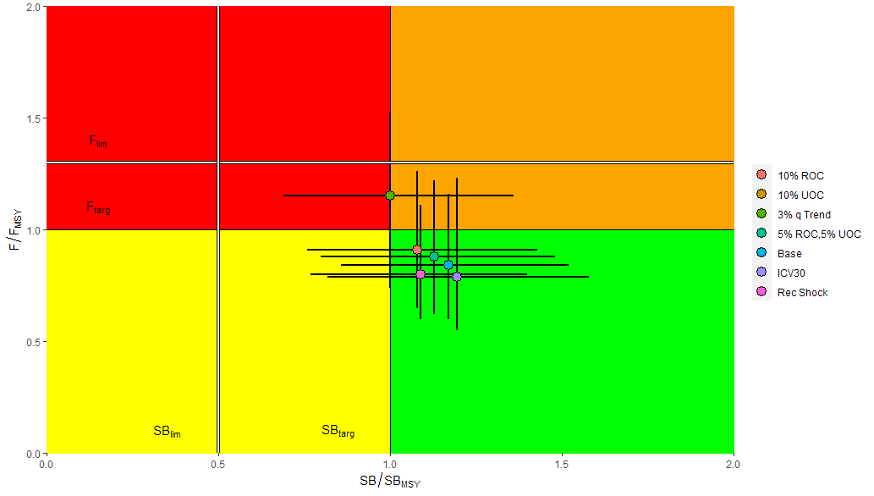
Robustness tests
Tend to have a predictable adverse effect, but not alarming
Except 3% per year CPUE catchability trend
Projection-based MP, B2 Tuning

Slide 23
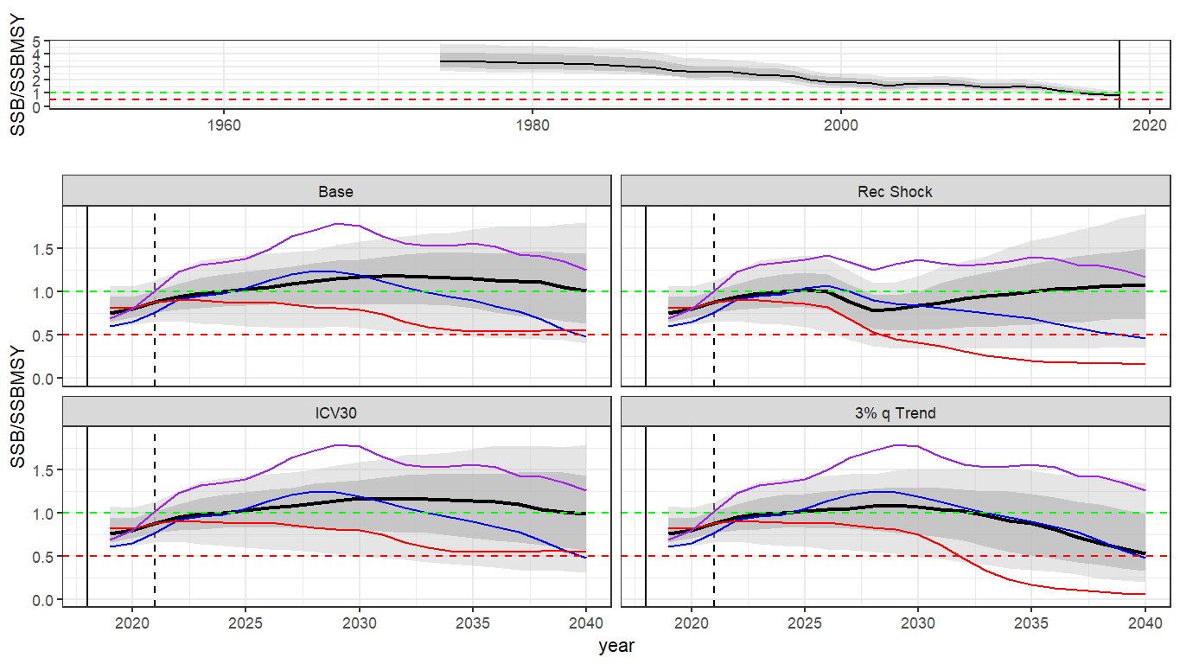
Robustness tests
Projection-based MP, B2 Tuning
Tend to have a predictable adverse effect, but not alarming
Except 3% per year CPUE catchability trend

Slide 24
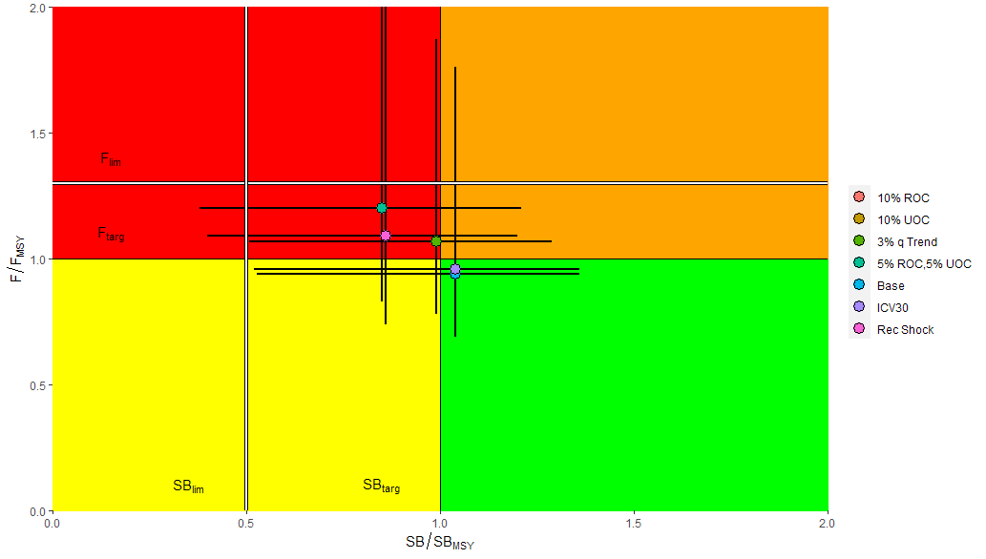
Robustness tests
CPUE-based MPs not as robust
3% per year CPUE catchability trend is not the worst outcome
CPUE-based MP, B2 Tuning
Tend to think that current CPUE-based MP is just not very good at responding to data

Slide 25
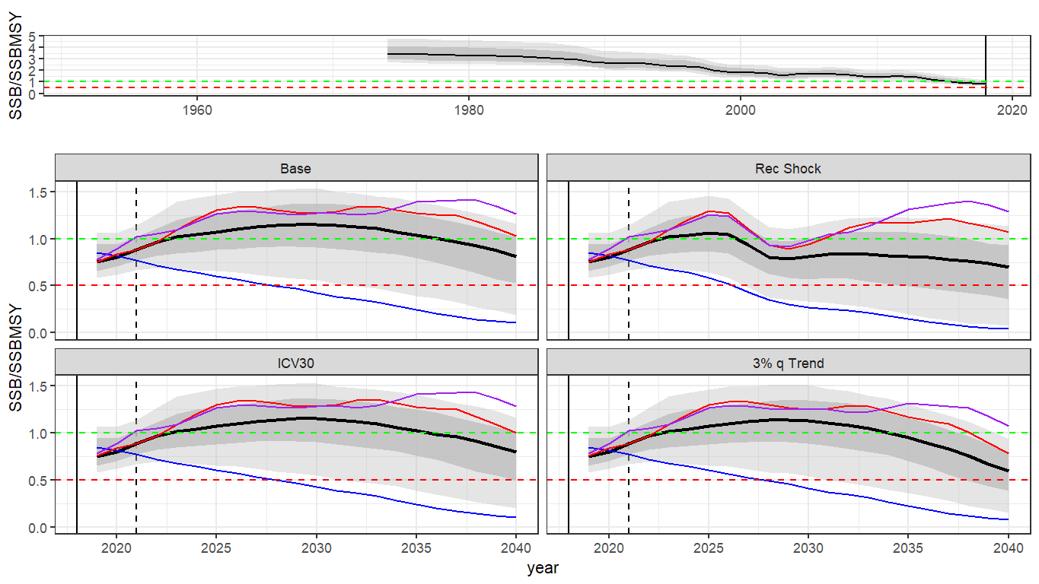
Robustness tests
CPUE-based MP, B2 Tuning
CPUE-based MPs not as robust
3% per year CPUE catchability trend is not the worst outcome
Tend to think that current CPUE-based MP is just not very good at responding to data

Slide 26
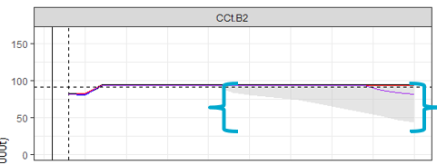
Revisiting some nuisance assumptions: Catch Equations and Spatial Refugia
What should happen if fishery cannot remove the TAC?
i.e. how would effort change?
What are implications for MP evaluations
Artefact of nuisance assumptions?

Slide 27
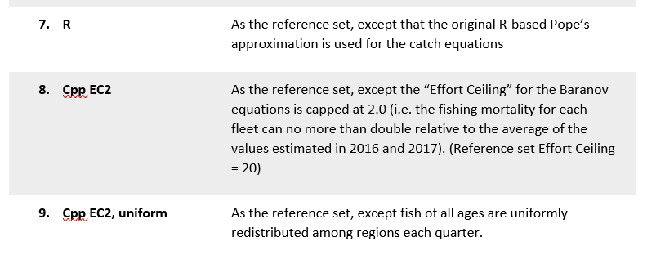
Revisiting some nuisance assumptions: Catch Equations and Spatial Refugia
3 new Robustness tests

Slide 28
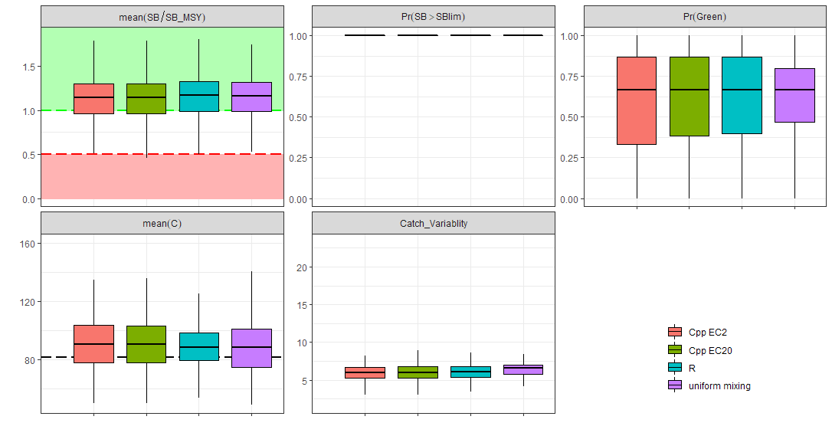
Seems not important for Bigeye
Hockeystick MP, B2 Tuning

Slide 29
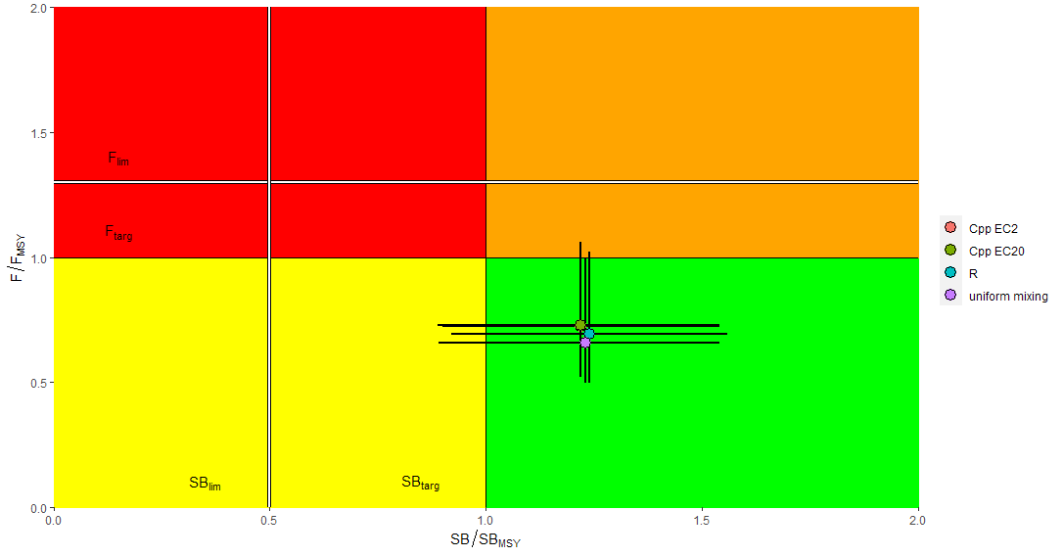
Seems not important for Bigeye
Hockeystick MP, B2 Tuning

Slide 30
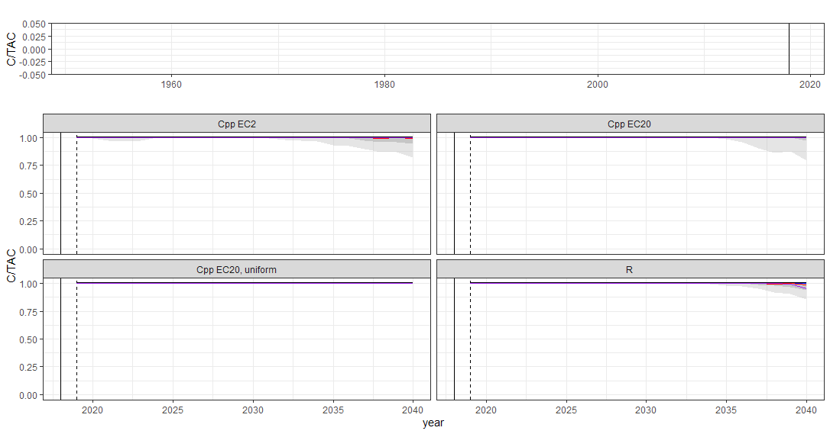
Seems not important for Bigeye
Hockeystick MP, B2 Tuning
TAC largely removed in all cases
…Yellowfin is a different story

Slide 31
Conclusions
No obvious problems with reference set OM identified
Trends in LL catchability will always cause performance divergence over time
B2 and B3 tuning objectives seem sensible and similar
Range of MP evaluation results presented.
Most promising the PTRE model-based hockey-stick and projection MPs
Recent MP tinkering effects very subtle
Robustness tests do not cause MP failure
BET MPs not very sensitive to “spatial refuge” assumptions

Slide 32
Requests from MSE Task Force
Selection of candidate MPs for TCMP presentation
Further OM development in line with new diagnostic approaches?
Continued MP development?
Apply the “Butterworth guillotine” and start to operationalize MP adoption mechanism?

Slide 33
Merci Thanks!
With thanks to the Australian Department of Foreign Affairs and Trade and FAO/IOTC for funding support, and the WPTT, WPM, TCMP and MSE Task Force for constructive engagement, and the legacy of countless clever modellers, statisticians, computer scientists and biologists upon which everything is built.

Slide 34
BET MSE Follow-up
Assessment and OM divergence?
Impact of alternate regional scaling factors?
How often is TAC change constraint hit?

Slide 35
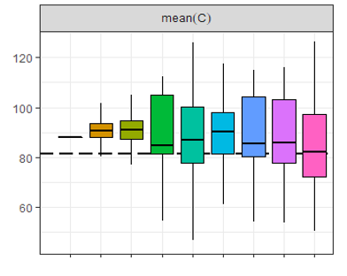
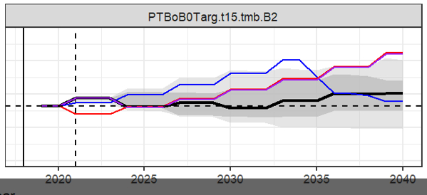
Note that median projected catch > Catch(2019)
C(2019)

Slide 36
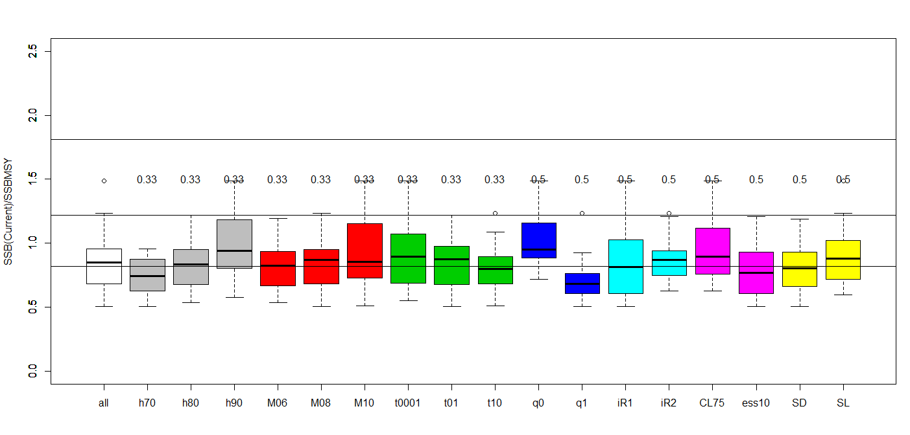
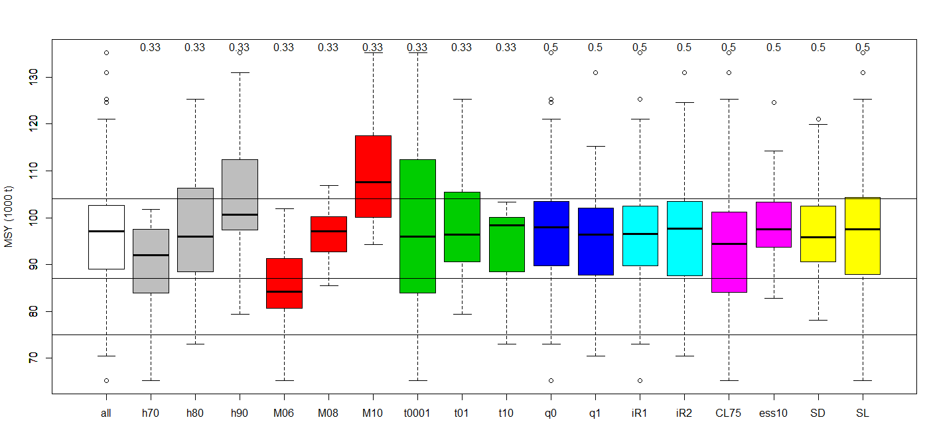
OM (WPM 2020 working paper) vs Fu (2019) BET stock status (disaggregated by assumption levels)
SSB(2018)/SSB(MSY) – OM more pessimistic
assessment
All models
CPUE q trend – not in assessment
MSY – OM more optimistic
assessment

Slide 37

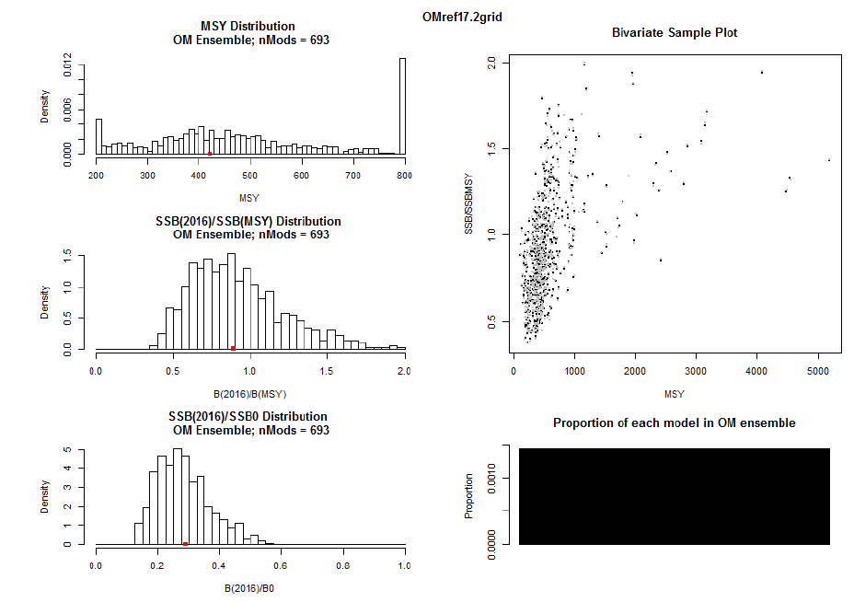
Do we care about disconnect between OM and assessment? Revisiting YFT 2018
Initial grid very diffuse and different from stock assessment

Slide 38
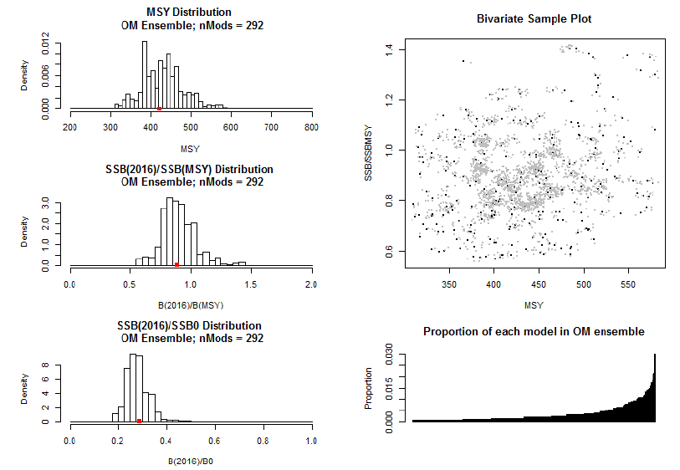
Do we care about disconnect between OM and assessment?
Sample grid
Initial grid very different from stock assessment
Proposed bivariate sampling of grid with respect to MSY and depletion
Match mean MSY and depletion from assessment (with correlation)
Arbitrarily inflate variance (2 X SA)

Slide 39
OM (WPM 2020 working paper) vs Fu (2019) stock status (disaggregated by assumption levels)
SSB(2018)/SSB(MSY)
assessment
All models
Regional Scaling factors
MSY
assessment

Slide 40
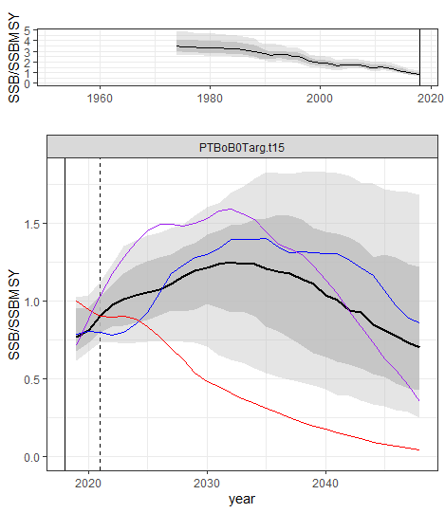
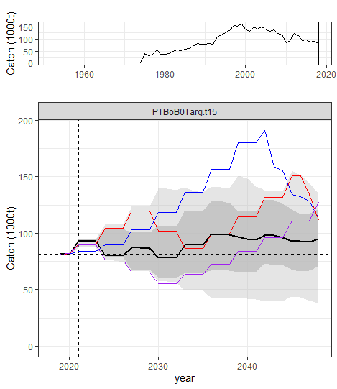
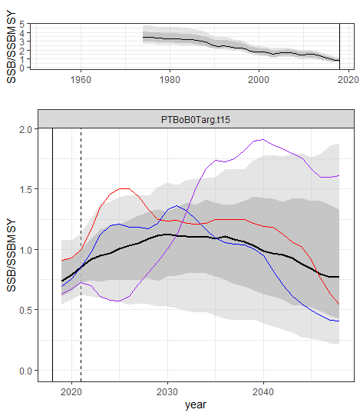
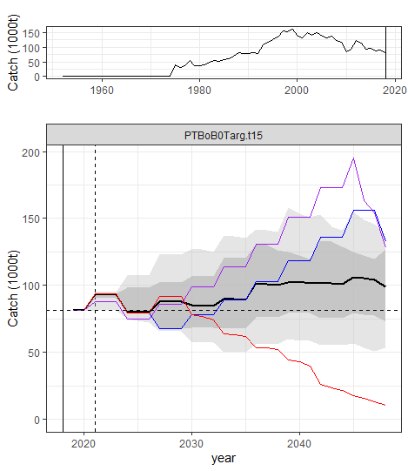
Regional Scaling Factor effect on MP performance
Similar, but note:
OM Grid not balanced
Stochasticity not duplicated
7994_m8
8000_m8
(PTRE projection MP)

Slide 41
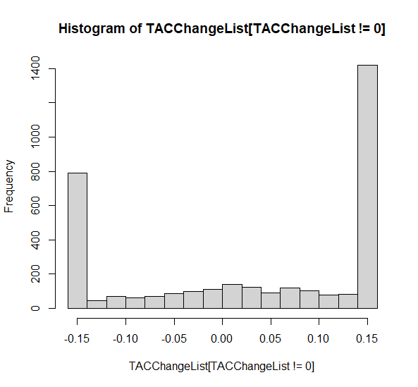
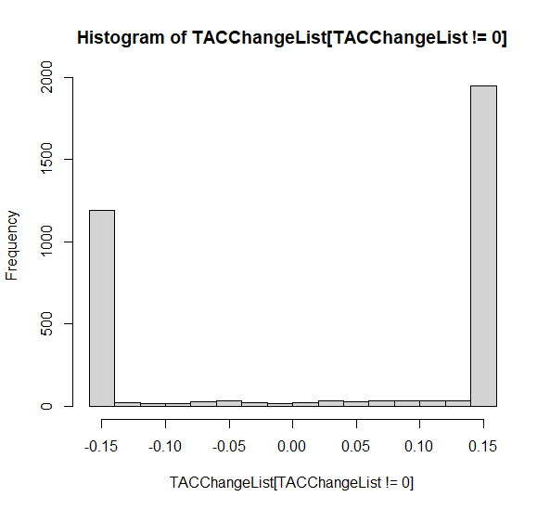
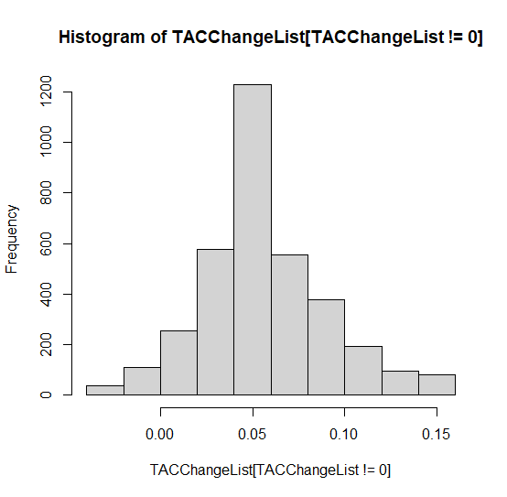
How often is 15% change constraint active 2021 – 2040?
PTRE Hockeystick
PTRE projection MP
CPUE trend MP

Slide 42
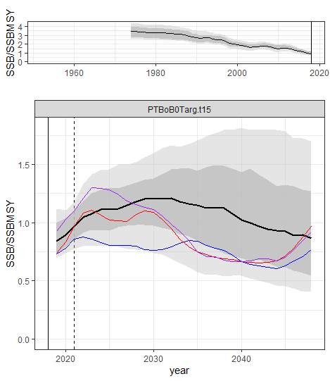
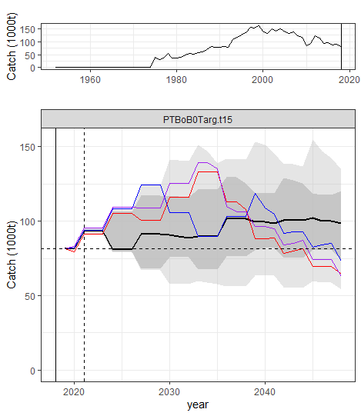
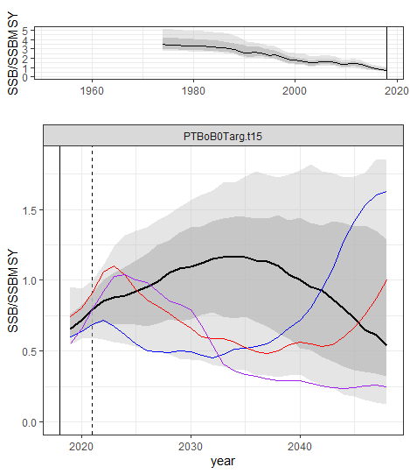
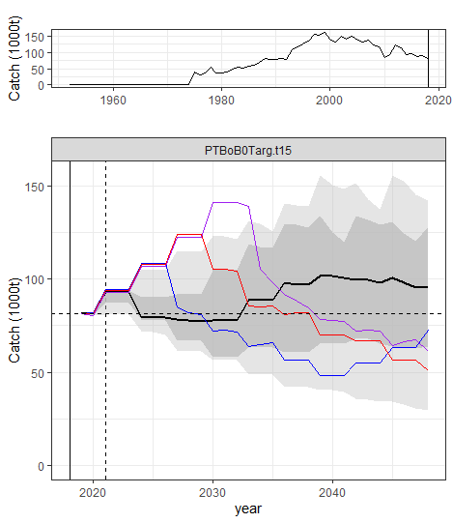
CPUE q trend effect on MP performance
Catch very similar
More SSB decline in q trend scenario
No trend
1% per year through conditioning and projections
(PTRE projection MP)

